Slide 1
POSSESSIVE ADJECTIVES
& PRONOUNS

Slide 2
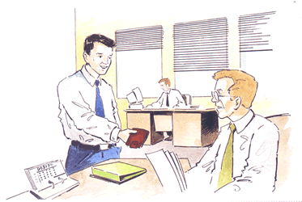
POSSESSIVE ADJECTIVES
& PRONOUNS
A: Is this your wallet?
A: Is this your wallet?
B: No, it isn’t my wallet.
B: No, it isn’t mine.
A: Whose is it, then?
A: Whose is it, then?
B: I think it’s Simon’s. His wallet is brown.
B: I think it’s Simon’s. His is brown.

Slide 3
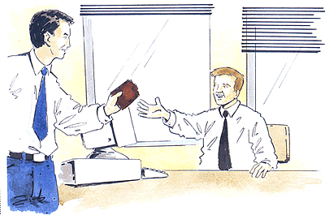
POSSESSIVE ADJECTIVES
& PRONOUNS
A: Simon, is this yours?
C: Yes, it’s mine.

Slide 4
POSSESSIVE ADJECTIVES
& PRONOUNS
POSSESSIVE ADJECTIVES
POSSESSIVE PRONOUNS
MY
MINE
YOUR
YOURS
HIS
HIS
HER
HERS
ITS
XXXXXXX
OUR
OURS
YOUR
YOURS
THEIR
THEIRS

Slide 5
POSSESSIVE ADJECTIVES
& PRONOUNS
Possesive adjectives/pronouns show:
that something belongs to somebody
b) the relationship between two or more people.
c) we put possessive adjectives before nouns.
d) possessive pronouns are not followed by nouns.
This is my bag. This bag is mine.
That is their car. That car is theirs.

Slide 6
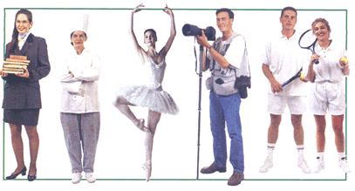
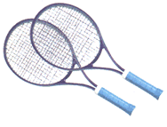
Match the objects with the people and make sentences.
These are the players’ rackets.
These are
their
rackets.
These rackets are
theirs.
rackets

Slide 7

Match the objects with the people and make sentences.
These are the chef’s spoons.
These are
her
spoons.
These spoons are
hers.
spoons

Slide 8
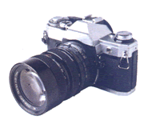
Match the objects with the people and make sentences.
This is the photographer’s camera.
This is his camera.
This camera is his.
camera

Slide 9
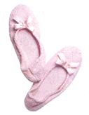
Match the objects with the people and make sentences.
These are the dancer’s shoes.
These are her shoes.
These shoes are hers.
shoes

Slide 10
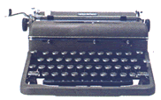
Match the objects with the people and make sentences.
This is the teacher’s typewriter.
This is her typewriter.
This typewriter is hers.
typewriter

Slide 11
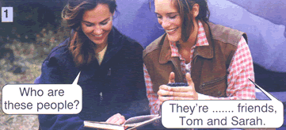
Fill in the gaps with the correct possessive
pronoun or adjective.
my

Slide 12
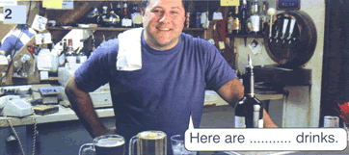
Fill in the gaps with the correct possessive
pronoun or adjective.
your

Slide 13
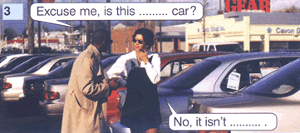
Fill in the gaps with the correct possessive
pronoun or adjective.
your
mine

Slide 14
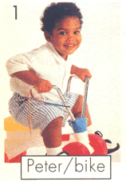
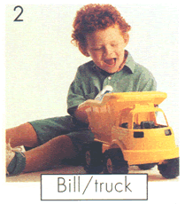
Answer the questions
Is this Peter’s bike?
Yes, it is. It’s his bike.
Yes, it is. It’s his.
Is this Bill’s truck?
Yes, it is. It’s his truck.

Slide 15
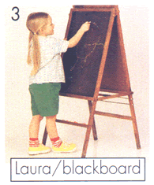

Answer the questions
Is this Laura’s blackboard?
Yes, it is. It’s her blackboard.
Yes, it is. It’s hers.
Is this Mary and Paul’s dog?
Yes, it is. It’s their dog.
Yes, it is. It’s theirs.

Slide 16
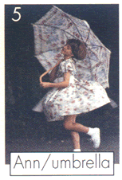
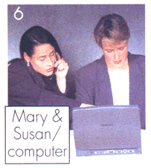
Answer the questions
Is this Ann’s Umbrella?
Yes, it is. It’s her umbrella.
Yes, it is. It’s hers.
Is this our computer?
Yes, it is. It’s our computer.
Yes, it is. It’s ours.

Slide 17
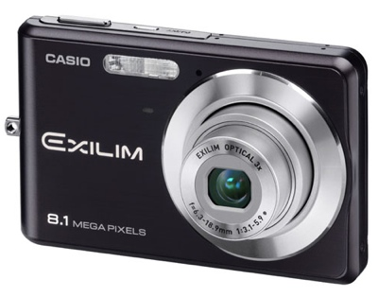
Whose is this?
me
you
her
him
us
you
them
It belongs to

Slide 18
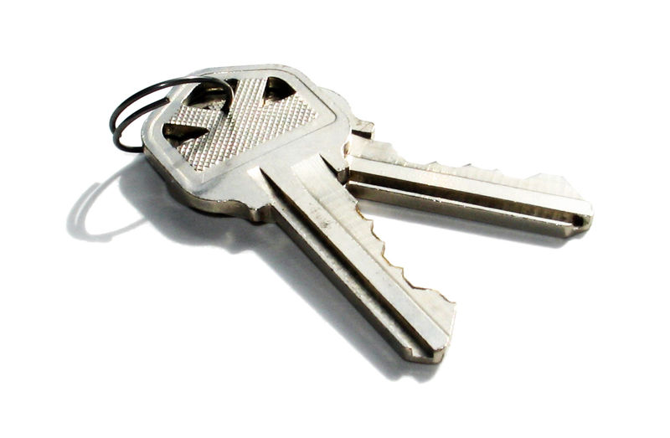
Whose are these?
me
you
her
him
us
you
them
They belong to

Slide 19
The pen is _______.
That book belongs to _____.
This is _____ pencil.
The backpack belongs to _____.

Slide 20
Ask me about the owner of the book.
Whose book is this?
Ask me if the brand new car is mine.
Does the brand new car belong to you?
Is the brand new car yours?
Is that your brand new car?

Slide 21
Ask me about the owner of the book.
Whose book is this?
Ask me if the brand new car is mine.
Does the brand new car belong to you?
Is the brand new car yours?
Is that your brand new car?
Give me advice about the clothes I need to travel
I think you should take a rain jacket.
Ask me for advice about a place to go on vacation.
Where should I go?
Where should I go on vacation?

Slide 22
Ask me about the weather in my city.
What's the weather like? / How's the weather?
Ask me about my travel preferences. Give me a choice.
How do you like to travel -by bus, plane, or car?
Give me advice about my trip abroad
I think you should take a lot of pictures and get your visa this week.

